Slide 1
Project plan: Edge detection
Sequoia Andrade

Slide 2
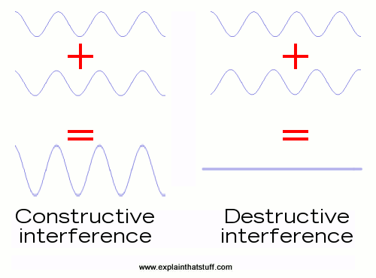
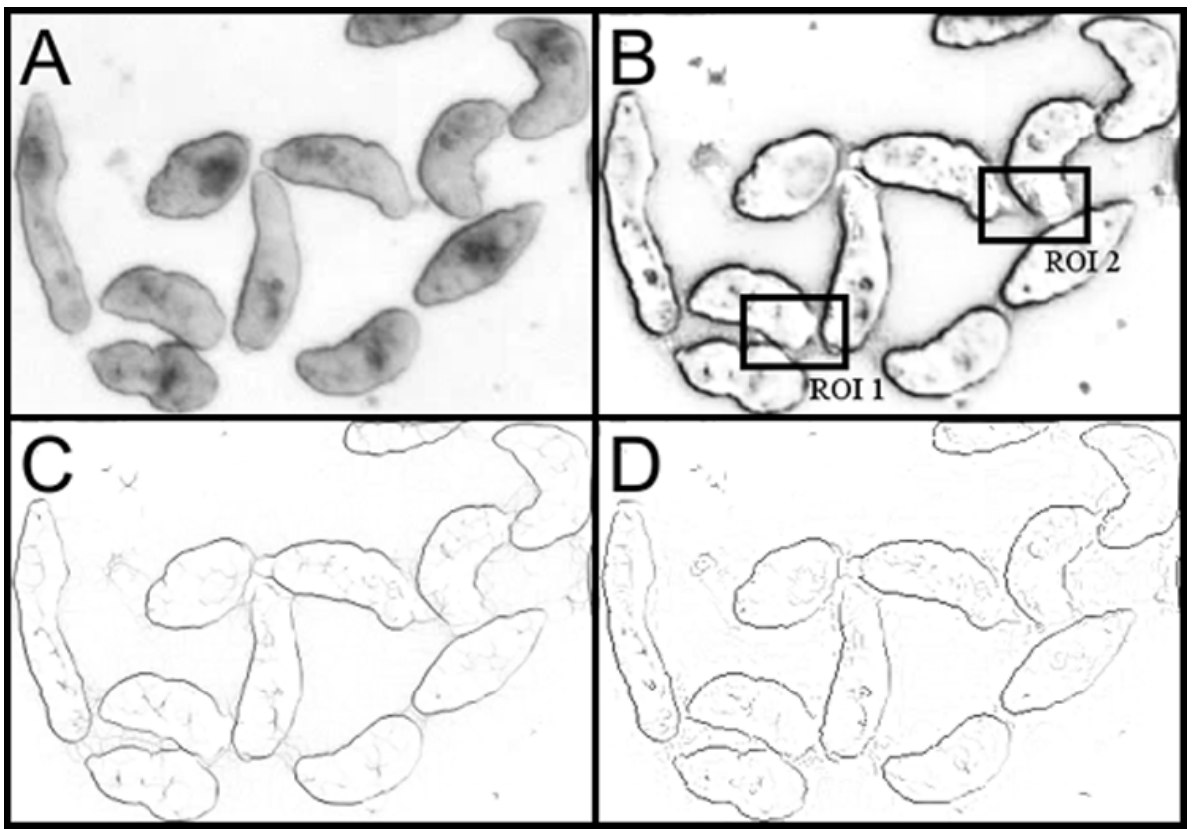
Motivation
[1]
Look into edge detection, and in particular phase congruency, where two or more parasites are touching
Idea: Where two objects touch is an instance of interference between their two Fourier series
Constructive interference:
Edge is more defined
Phase congruency is in the same direction for both objects
Destructive interference:
Edge is missing or less defined
Phase congruency is in the opposite direction for the objects
Need to track the phase congruency pre-, active-, post- contact
[2]

Slide 3
Method
Implement phase congruency edge detection:
Use Peter Kovesi’s code [3]
Experiment with different parameters:
Different wavelets for parasites in contact?
Variable thresholding?
Identify individual parasites through edge detection
Track parasites throughout a video
Record phase congruency data for parasites pre-, active-, and post- contact
Analyze data via time series
Changes in congruency magnitude and direction
[2]

Slide 4
Materials
Parasite images
Use for experimenting with phase congruency parameters
Parasite videos
Use for tracking parasites pre-, active-, and post-contact
Matlab
Vision toolkit for parasite tracking [4]

Slide 5
REferences
[1] https://kaiserscience.wordpress.com/physics/waves/interference-and-superposition/
[2] Asarnow, D.E., & Singh, R. (2013). Segmenting the Etiological Agent of Schistosomiasis for High-Content Screening. IEEE Transactions on Medical Imaging, 32, 1007-1018.
[3] https://www.peterkovesi.com/matlabfns/
[4] https://www.mathworks.com/help/vision/tracking-and-motion-estimation.html

